Slide 1


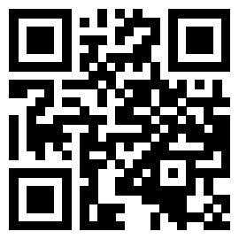
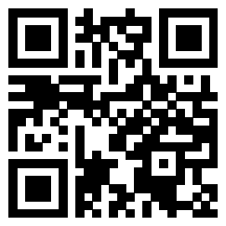
Demystifying APIs
Join our Slack:
Sign-in:
go.osu.edu/BDAAsignin
go.osu.edu/bdaaslack

Slide 2
Zoom Etiquette & Code of Conduct
Please keep your mic on mute unless talking
Questions are welcome and encouraged at any time! Just please ask in the chat during the presentation
This meeting will be recorded and posted publicly later. By continuing to be in this workshop, you consent to this recording and its publication
BDAA aspires to create a community built on collaboration, innovation, creativity, and belonging within and across disciplines. To inspire, empower, and connect all members -- whatever race, gender, age, ethnicity, cultural heritage or nationality; religious or political beliefs; sexual orientation or gender identity; or socioeconomic, veteran or ability status -- BDAA is committed to an intersectional, persistent, and self-aware movement towards equal opportunity.
By participating in this workshop, you agree to abide by our code of conduct in support of these values (bdaaosu.org/conduct/)

Slide 3
Demystifying APIs
Join our Slack:
Sign-in:
go.osu.edu/BDAAsignin
go.osu.edu/bdaaslack

Slide 4

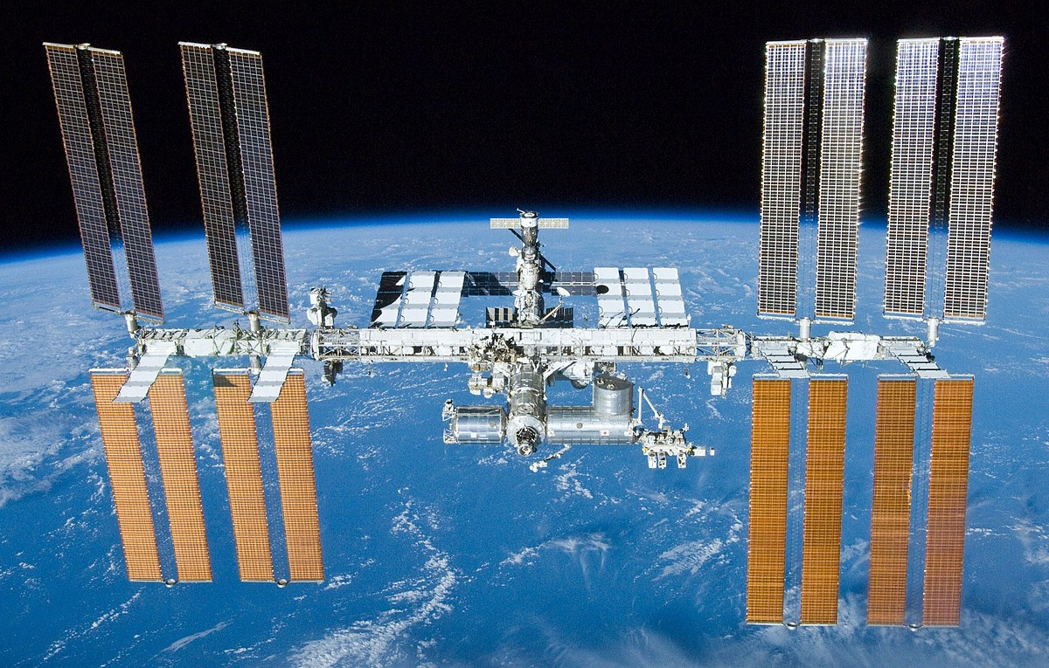

Today We Will...
Learn about APIs, HTTP Requests, JSON, etc…
Use some APIs!

Slide 5


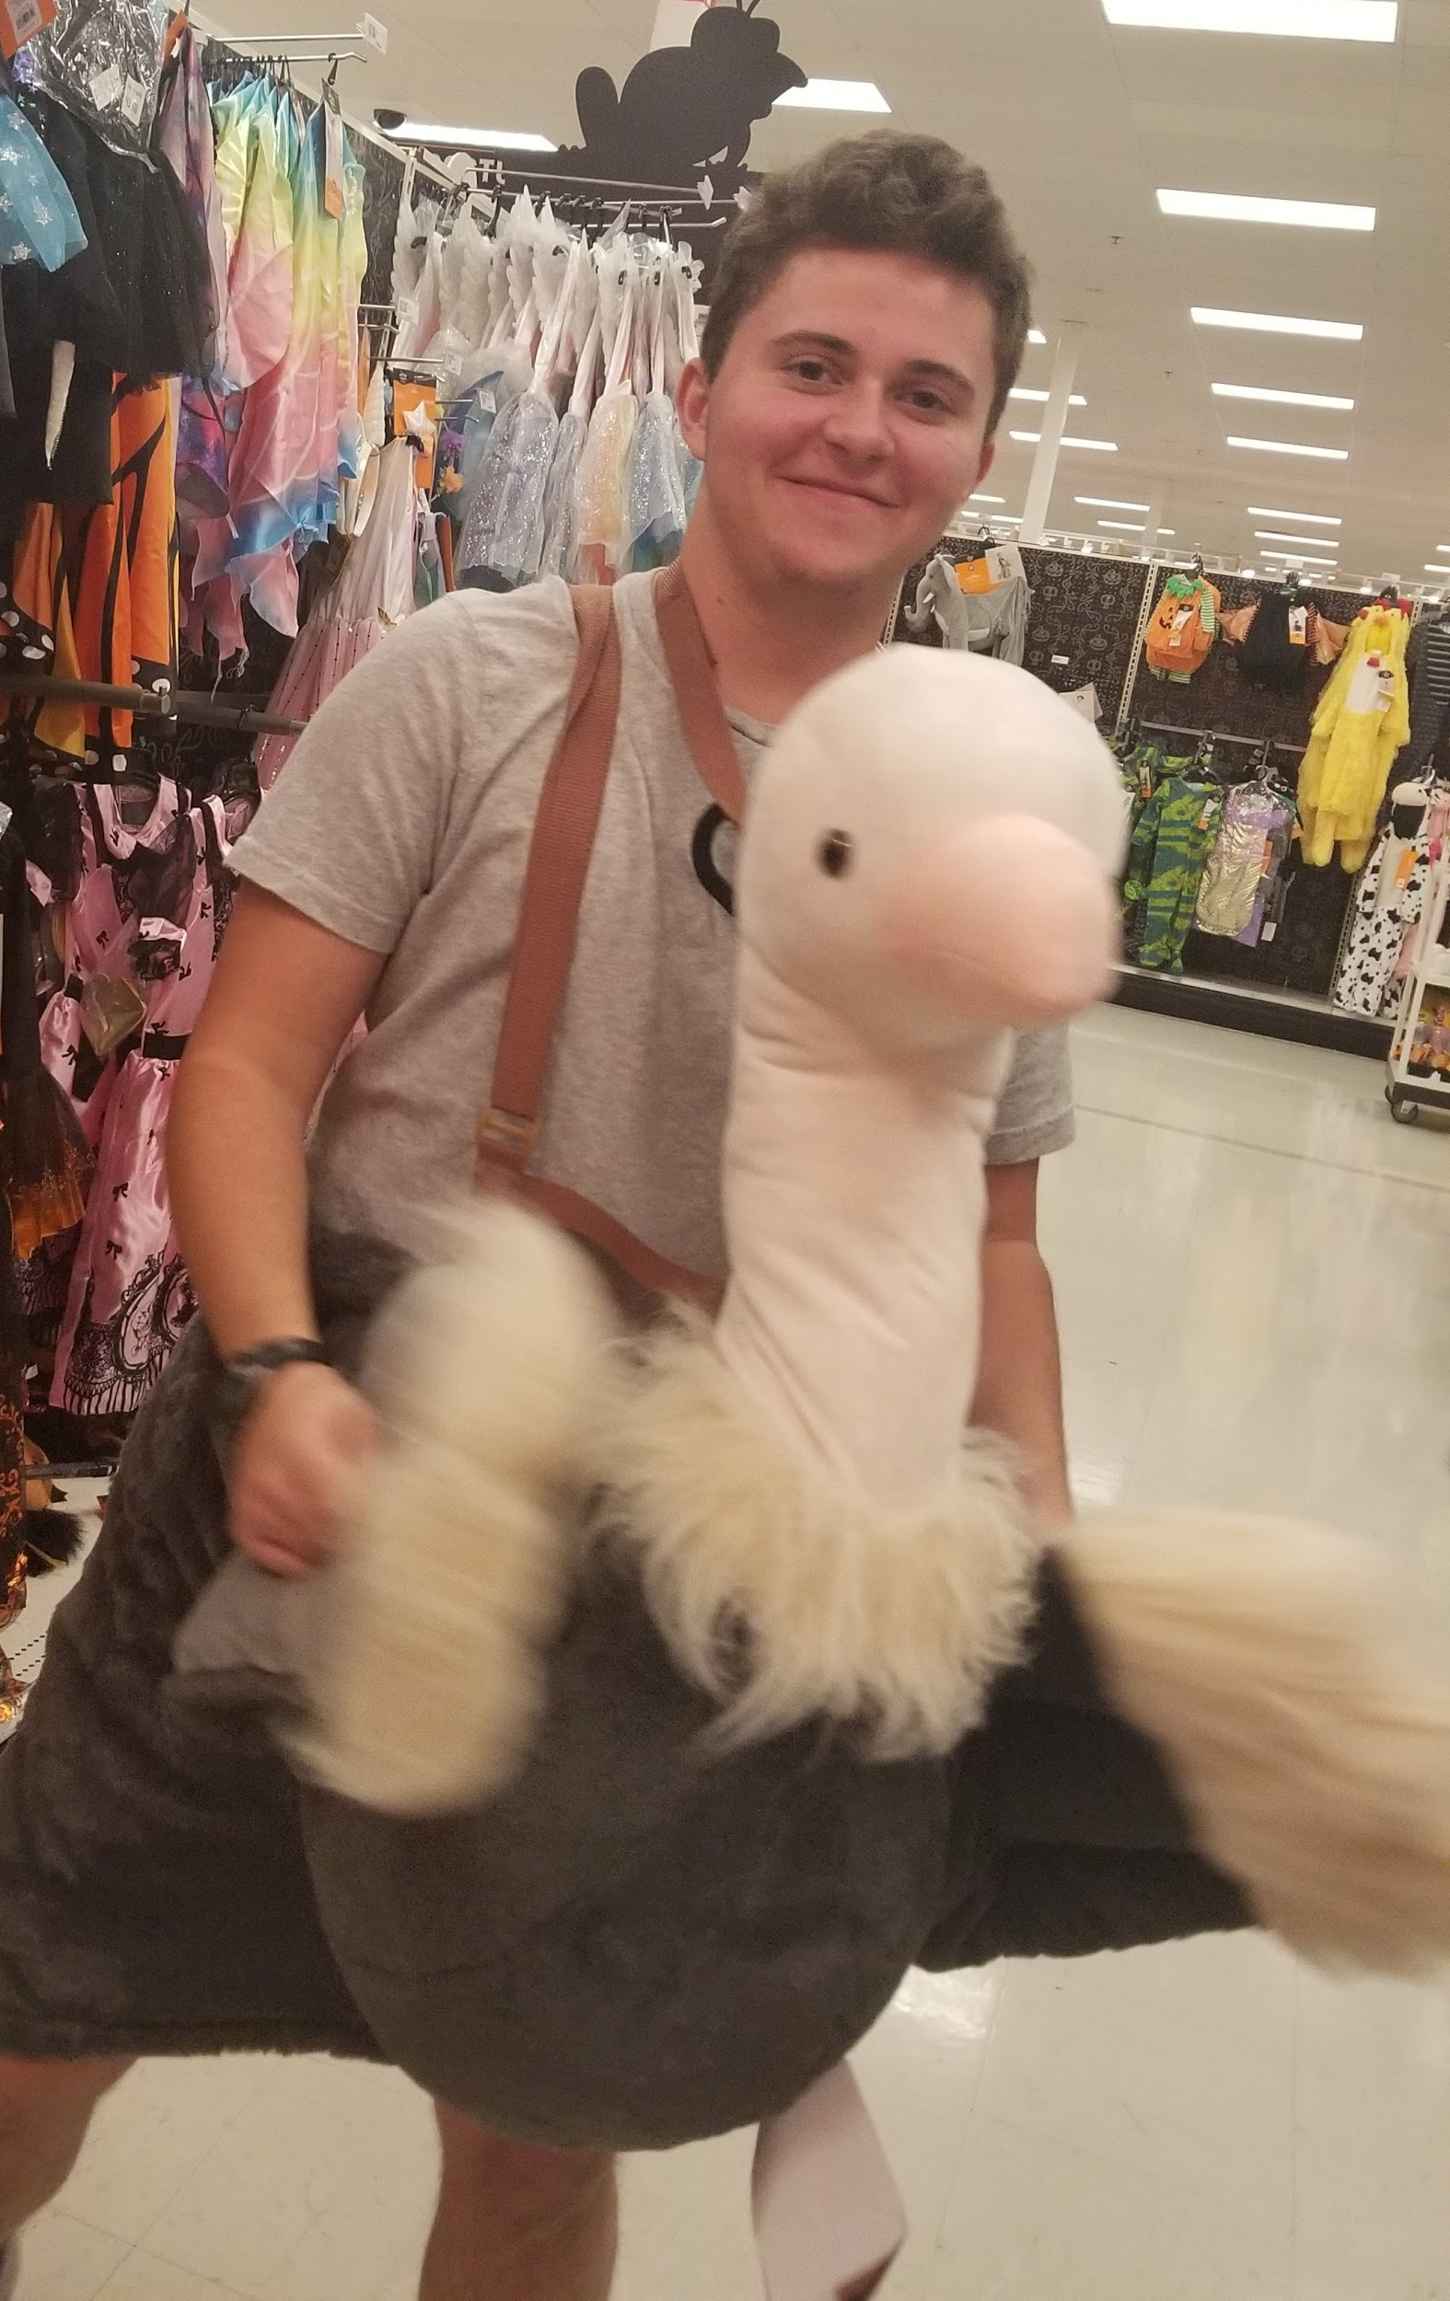
Who am I?
Leo Glowacki (he/him/his)
5th Year
Major: Data Analytics and Music
BDAA Education Director
Certified RStudio Instructor
Sweater or Hoodie?

Slide 6
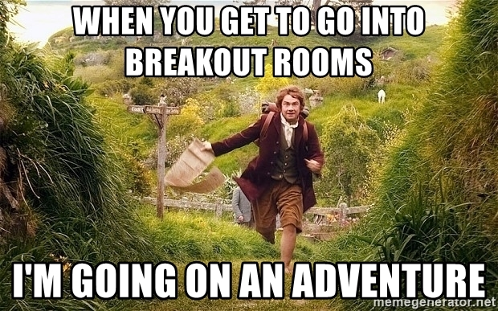
3 Min Intro Breakout Rooms
Name
Major
Year
Where are you from?
Sweater or Hoodie

Slide 7
A potential alternative to web scraping… APIs
Same goal as web scraping - get the data
APIs can also interact with the system
Usually register w/service & make calls to it that are followed by a response
Pros:
Formatting is usually easier
Usually legal if/when scraping is not
Easier when interaction is necessary
Cons:
Not all websites/services have APIs
Data not always current
Rate limits

Slide 8
What is an API?
Application Programming Interface
Easy, defined way to interact with a system
Defines:
the kinds of calls or requests that can be made
how to make them
the data formats that should be used
the conventions to follow
etc.

Slide 9
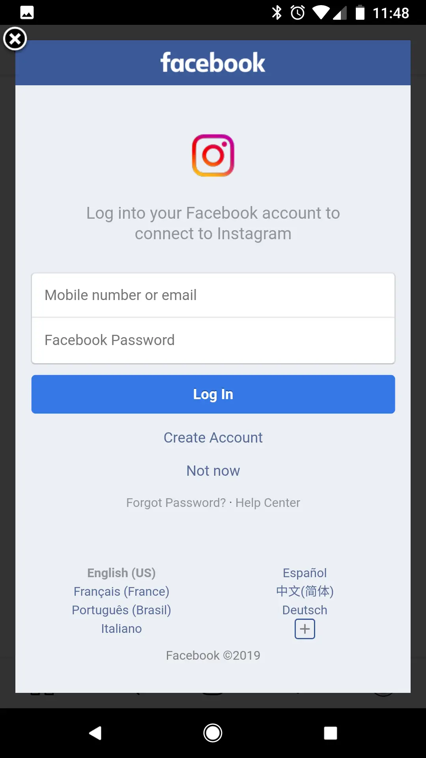
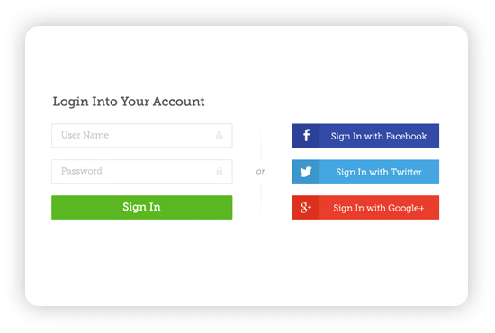
API Uses
Notes:
Data scientists mostly use it for getting data

Slide 10
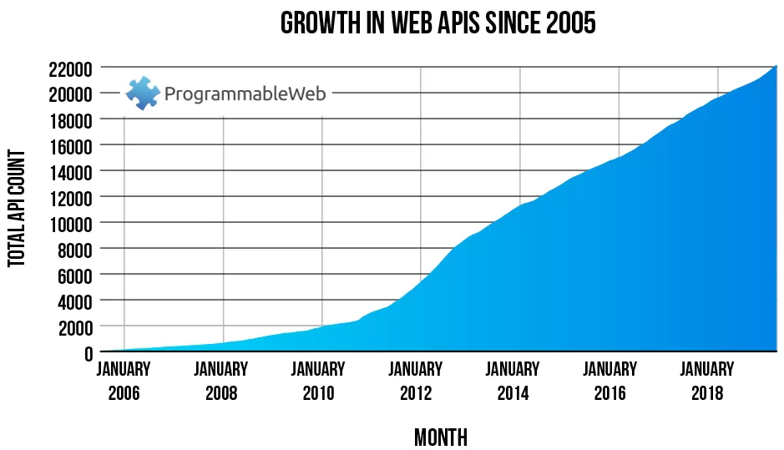
Who has APIs?

Slide 11




Who has APIs?
Lots of companies and websites...
github.com/public-apis/public-apis

Slide 12

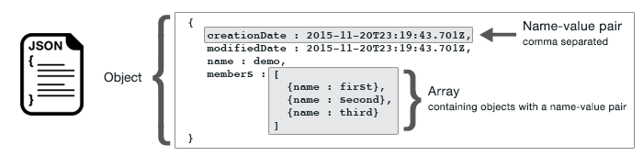
JSON
JavaScript Object Notation
Notes:
JSON is a language-independent data format. It was derived from JavaScript, but many modern programming languages include code to generate and parse JSON-format data.

Slide 13
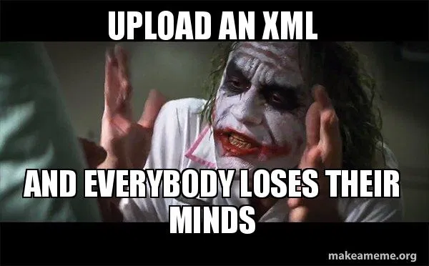
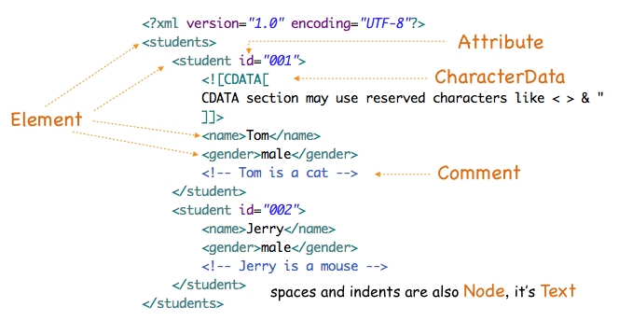
XML
Extensible Markup Language

Slide 14
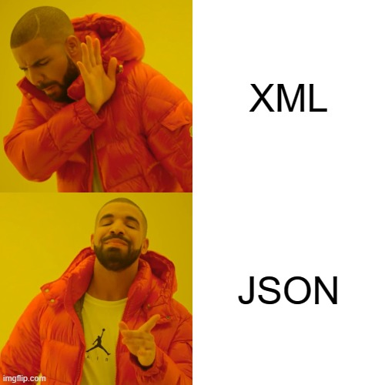
JSON vs. XML
XML is harder to parse than JSON
JSON is parsed into a ready-to-use JavaScript object.
More info:
w3schools.com/js/js_json_xml.asp

Slide 15
HTTP Response Status Codes
5 Main Classes:
Informational responses (100–199)
Successful responses (200–299)
Redirects (300–399)
Client errors (400–499)
Server errors (500–599)
wikipedia.org/wiki/List_of_HTTP_status_codes

Slide 16

Get the R Code
Go to this link: https://go.osu.edu/api_code
Sign in or create account
Join Space
Click "Projects" at the top
Select the "APIs" Project
Wait for project to deploy
Select "API_Workshop.Rmd" (bottom right)
Notes:
R is a programming language
You can program R in RStudio/RStudio Cloud
Name parts in RStudio
Knitting gets your results
Load times- be patient, don't refresh
Ensure no pop up blockers preventing RMarkdown

Slide 17
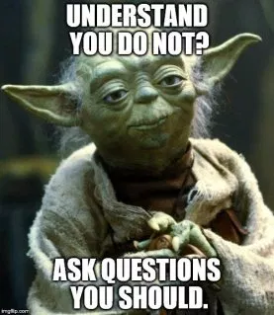
Questions?
Any Questions?
BDAA Slack R Learning Community!
go.osu.edu/bdaaslack
My Contact Info:
Leo Glowacki
Message me on Slack!
www.LeoGlowacki.com

